Slide 1
Immunobump Mock-up Trial Proof-of-Concept
Benjamin H. Wunsch
2018, November 1
Nanobiotechnology Group, HCLS
T.J. Watson Research Center, IBM

Slide 2
Experiment
Observe changes in lateral displacement of coupled biotinylated and streptavidin-coated beads.
Materials:
<d_{p}> = 40nm, biotin coated polystyrene bead, 470/510 ex/em fluorescence (Thermo Fisher)
<d_{p}> = 40nm, neutravidin (streptavidin mutant) coated polystyrene bead, 560/610 ex/em fluorescence (Thermo Fisher)
PUZZEL1.W5 – C10 pattern: monoloader, condenser + nanoDLD, P400G150
Protocol:
Sonicate 500 µL, 1:10 v:v PBS dilutions of each bead, 30 min
Mix beads at 1:1 and 1:10 biotin : neutravidin stock volumes, vortex 60 min at T_{R}
Dilute to 1:100 v:v with 5% w/v BSA in PBS
Filter 0.1 µm, Whatman
Pre-coat chip with 5% w/v BSA in PBS for 5 min, 2 bar injection pressure
Test individual beads and mixtures in chips at 8 bar injection pressure
Results:
Both beads show displacement spectra: one partial bump mode at η ~ 0.5, and a full bump mode η ~ 1.0. Very polydisperse sample
G150 arrays non-ideal (did not have G225 for testing)
1:1 mixtures precipitate completely
1:10 mixtures show a loss of the biotin bead partial bump – almost all events seen near the total bump mode – suggests smaller biotin beads have “gained” size through aggregation, presumably with neutravidin beads

Slide 3
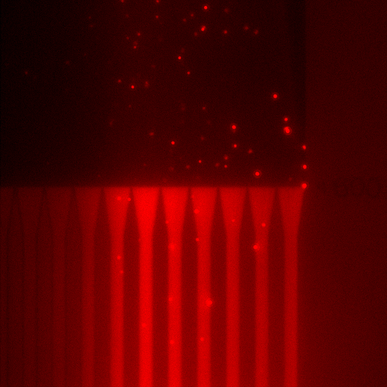
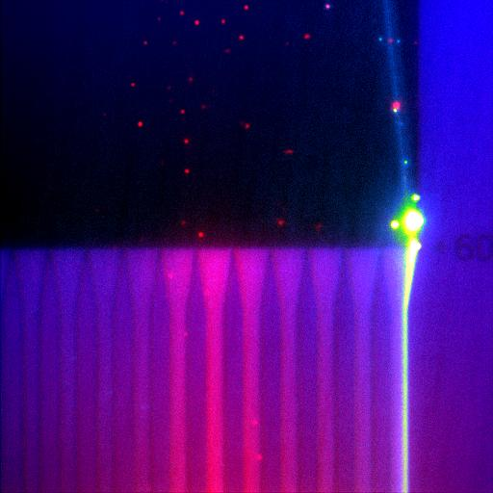
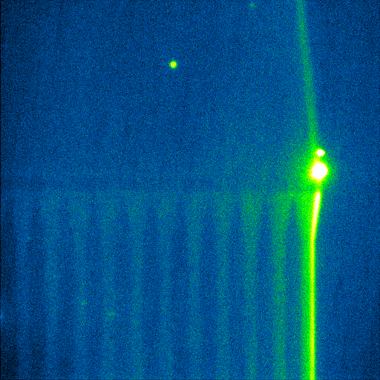
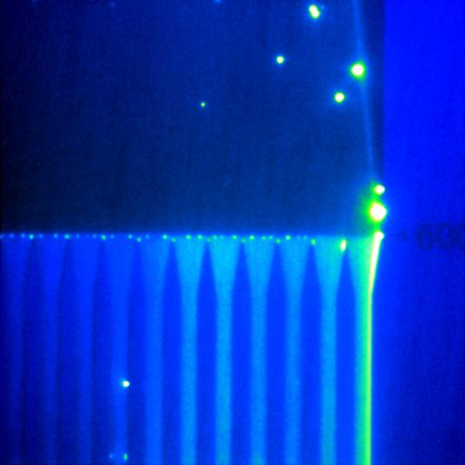
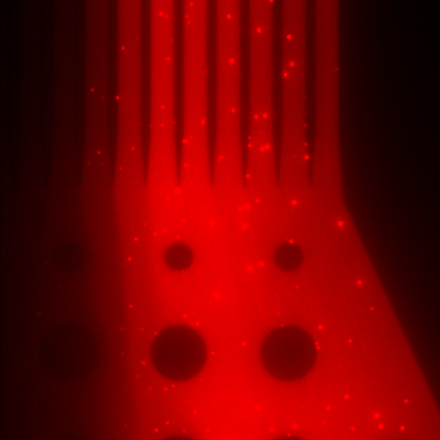
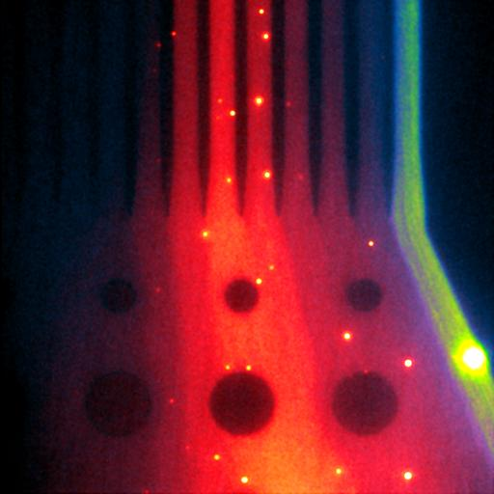
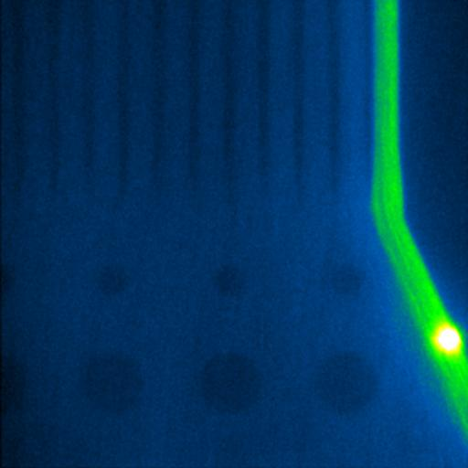
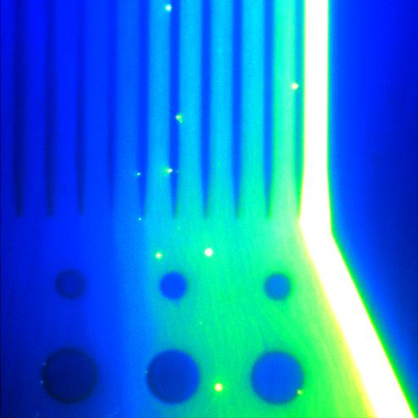
Results
Neutravidin
Neutravidin : Biotin
1:10 v:v
Neutravidin : Biotin
1:10 v:v
Biotin
470ex/510em – Biotin
560/610 - Neutravidin
470ex/510em – Biotin Only
470ex/510em – Biotin Only
470ex/510em – Biotin Only
20 µm
Array Outlet
Outlet Channels Terminus

Slide 4
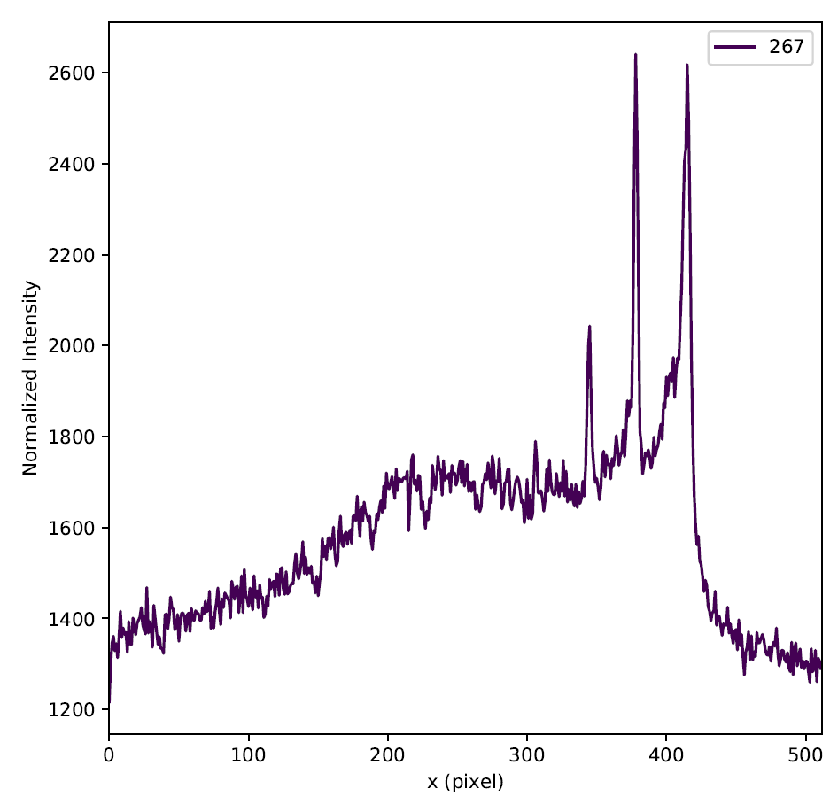
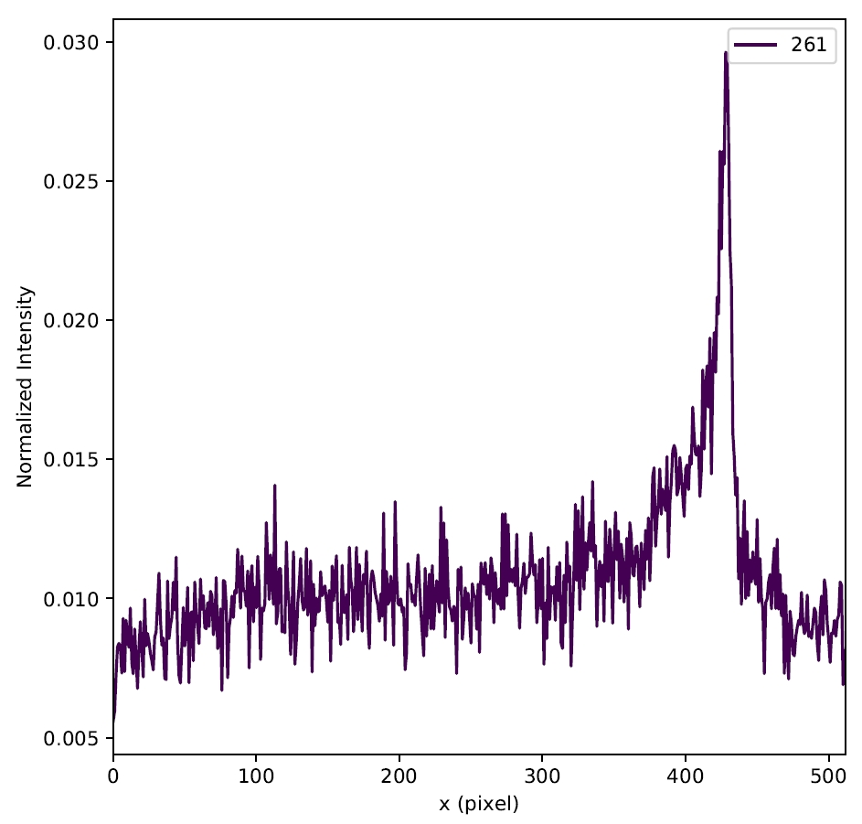
Results
Biotin
Biotin : Neutravidin, 1:10 v:v
470ex/510em – Biotin Only
470ex/510em – Biotin Only

